Slide 1
RESEARCH PAPER
Analyzing Book Features and Ratings Using Decision Tree, SVM, and Neural Networks
LAZEA Andreea-Elena
01

Slide 2

RESEARCH PAPER
02
Abstract
This study investigates the application of three different machine learning methods, Decision Trees, Support Vector Machines(SVM) and Neural Networks, on a book dataset, in order to uncover relationshios between book features and their respective ratings
LAZEA ANDREEA-ELENA

Slide 3
RESEARCH PAPER
03
Introduction
PART 1
LAZEA ANDREEA-ELENA

Slide 4
RESEARCH PAPER
04
Objectives
WHAT I WANT TO ACHIEVE
Evaluate Decision Trees, SVM, and Neural Networks on book rating data
Compare performance, interpretability, and computational efficiency
Identify actionable insights for book rating prediction
LAZEA ANDREEA-ELENA

Slide 5
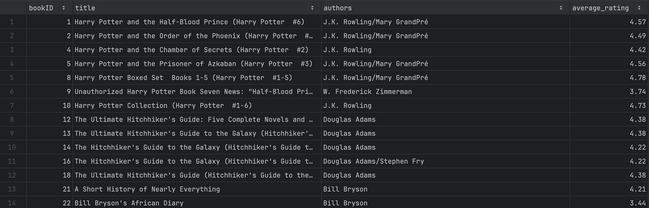
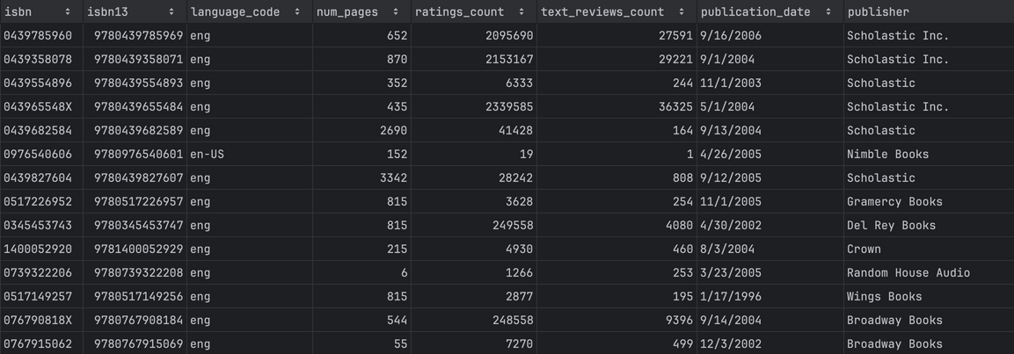
RESEARCH PAPER
05
Dataset Overview
SIZE: OVER 11,000 BOOKS
LAZEA ANDREEA-ELENA

Slide 6
RESEARCH PAPER
06
Methodology
PART 2
LAZEA ANDREEA-ELENA

Slide 7
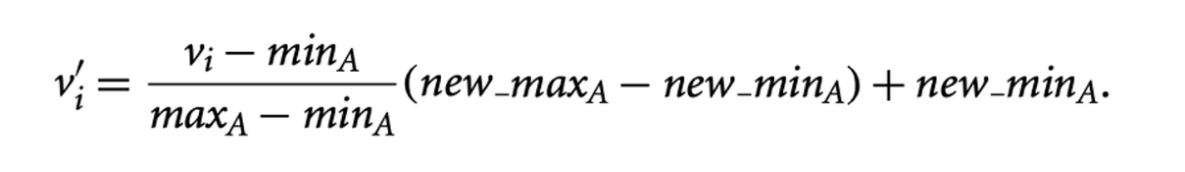
RESEARCH PAPER
07
Data Preprocessing
HANDLED MISSING VALUES
NORMALIZED NUMERICAL ATTRIBUTES
SPLIT DATA INTO TRAINING 80% AND TESTING 20%
LAZEA ANDREEA-ELENA

Slide 8
RESEARCH PAPER
08
Methods Used
DECISION TREES
SVM
NEURAL NETWORK
Rule-based classification
Linear kernel for classification
Regression with non-linear relationships
LAZEA ANDREEA-ELENA

Slide 9
RESEARCH PAPER
09
Decision Trees
PART 3
LAZEA ANDREEA-ELENA

Slide 10
RESEARCH PAPER
10
KEY FEATURES
ratings_count
text_reviews_count,
year,
num_pages
Decision Trees
RESULTS
Accuracy: 59.2%
LIMITATIONS AND STRENGTHS
Strengths: High interpretability
Limitations: Susceptible to overfitting, struggles with overlapping data
LAZEA ANDREEA-ELENA

Slide 11
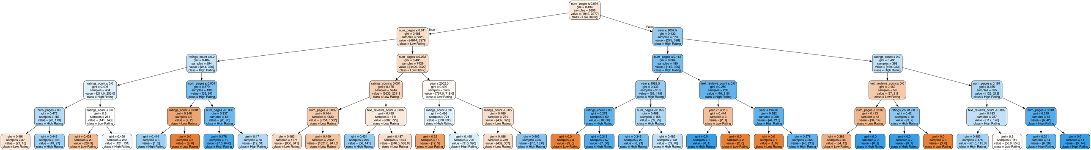
RESEARCH PAPER
11
Decision Tree Structure
LAZEA ANDREEA-ELENA

Slide 12
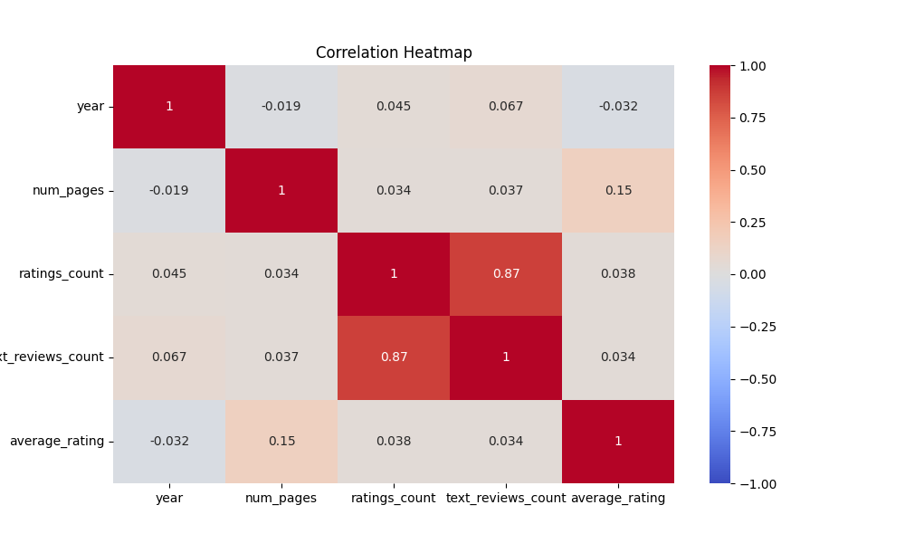
Correlation Heatmap
RESEARCH PAPER
12
LAZEA ANDREEA-ELENA

Slide 13
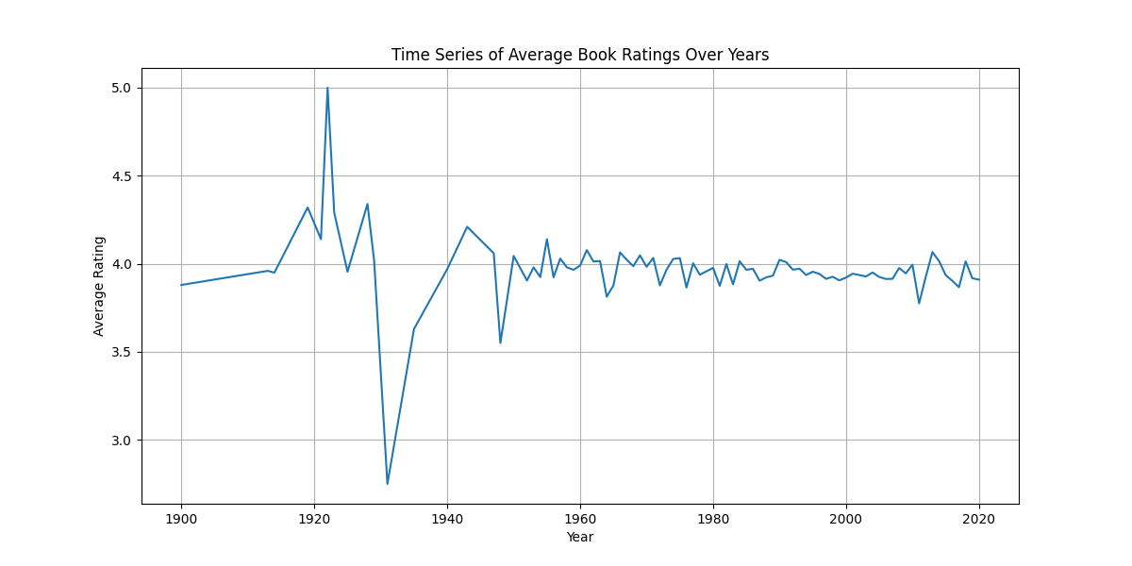
RESEARCH PAPER
13
Time Series of Average Ratings Over Years
LAZEA ANDREEA-ELENA

Slide 14
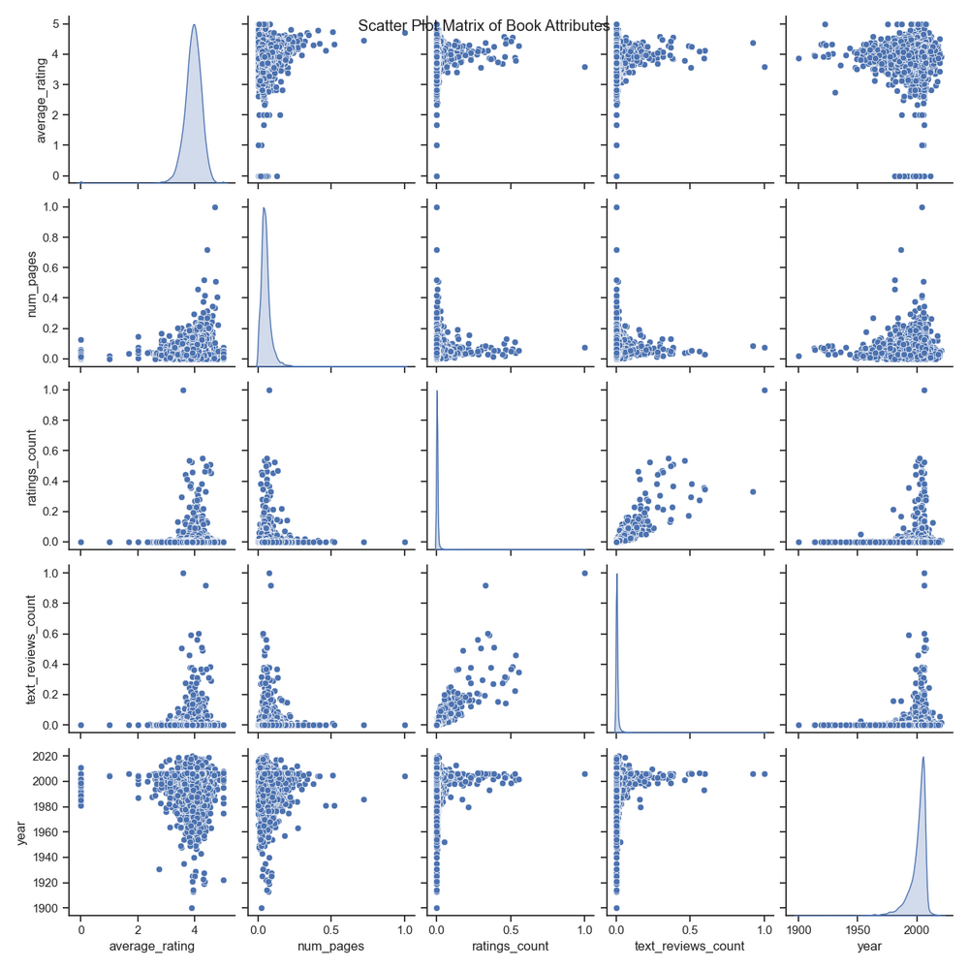
RESEARCH PAPER
Scater Plot Matrix
14
LAZEA ANDREEA-ELENA

Slide 15
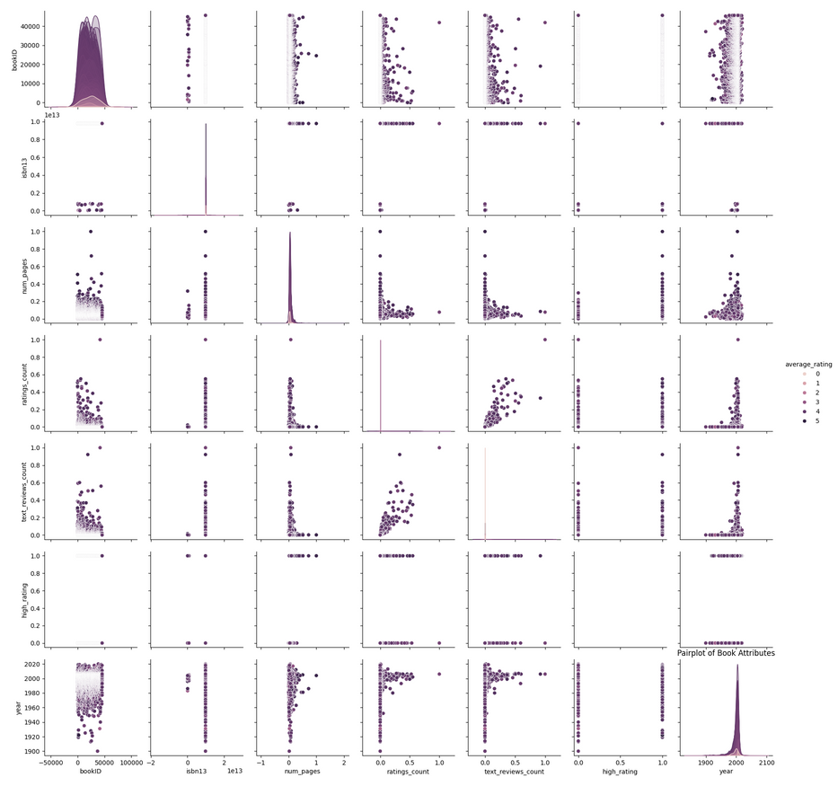
RESEARCH PAPER
15
Pair Plot for Attribute Interactions
LAZEA ANDREEA-ELENA

Slide 16
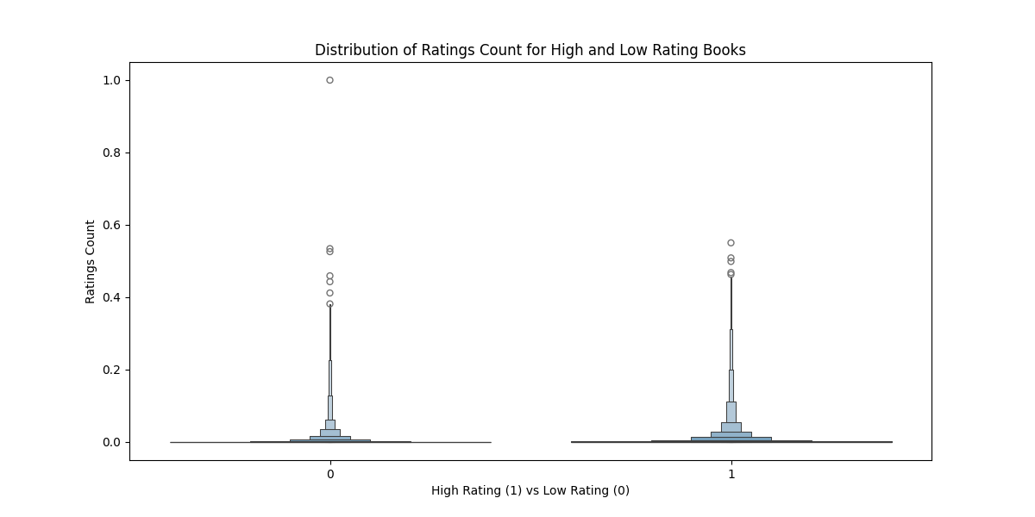
RESEARCH PAPER
16
Distribution of Ratings Count
LAZEA ANDREEA-ELENA

Slide 17
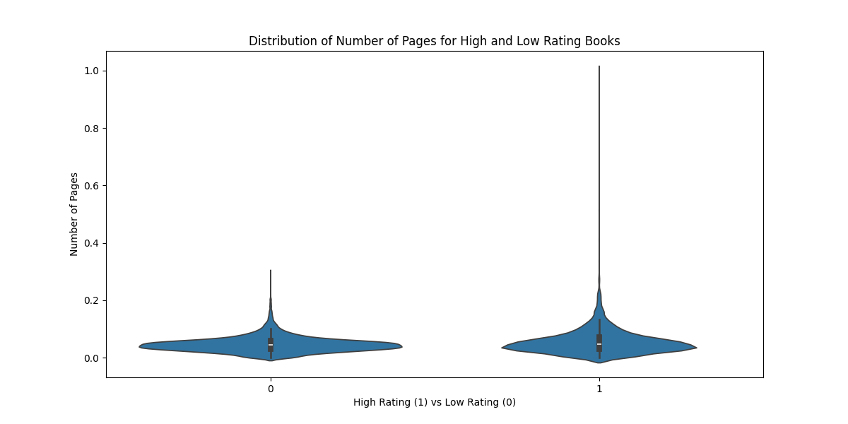
RESEARCH PAPER
Distribution of Number of Pages
17
LAZEA ANDREEA-ELENA

Slide 18
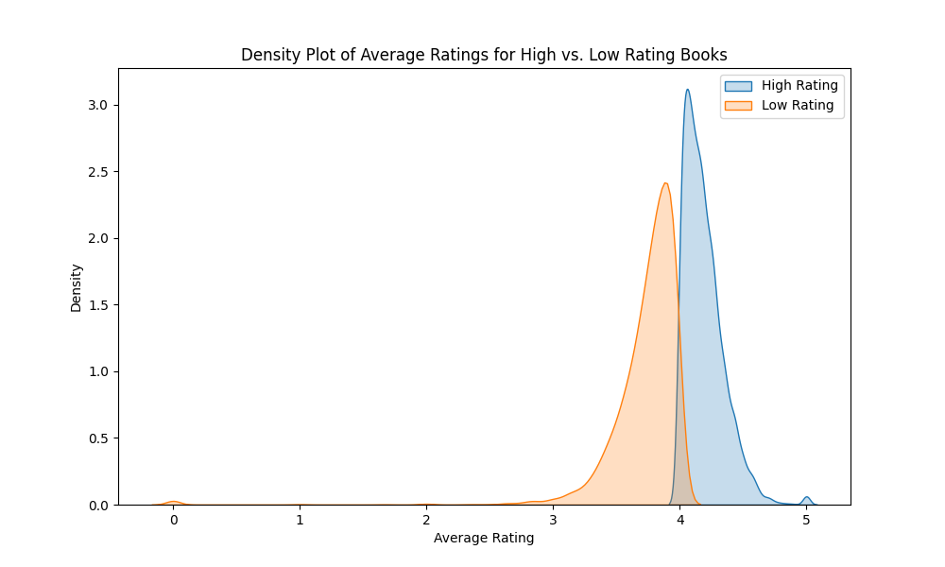
RESEARCH PAPER
18
Density Plot of Average Ratings vs Low Ratings
LAZEA ANDREEA-ELENA

Slide 19
RESEARCH PAPER
19
Neural Network
PART 4
LAZEA ANDREEA-ELENA

Slide 20
RESEARCH PAPER
20
APPROACH
Regression analysis for predicting average_rating
Neural
Network
RESULTS
MAE: 0.23
LIMITATIONS AND STRENGTHS
Strengths: Handles non-linear relationships, high accuracy
Limitations: Computationally intensive, less interpretable
LAZEA ANDREEA-ELENA

Slide 21
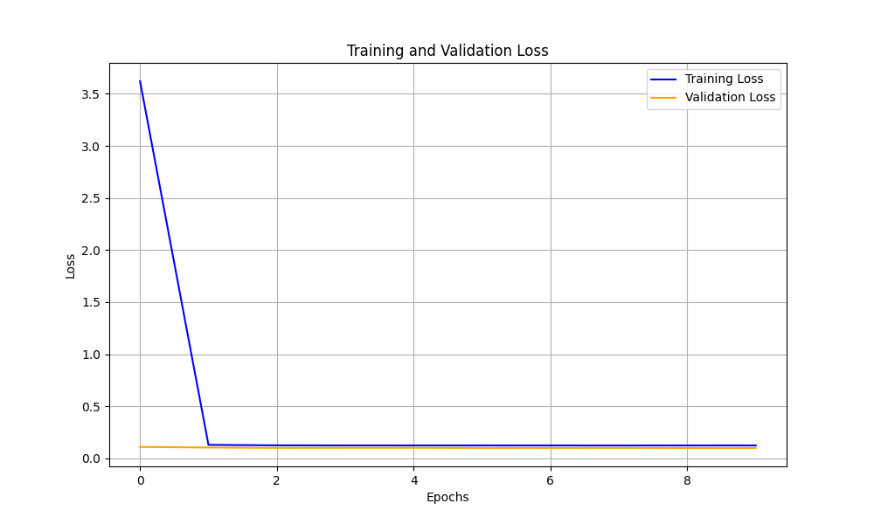
RESEARCH PAPER
Training validation loss
21
LAZEA ANDREEA-ELENA

Slide 22
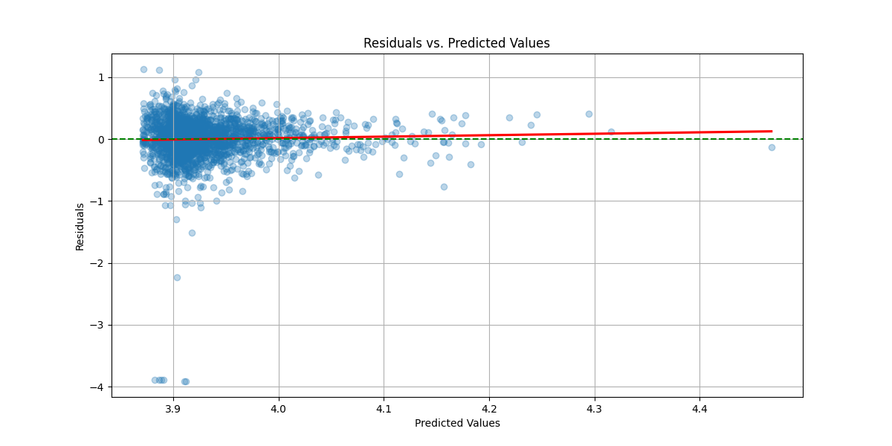
RESEARCH PAPER
Residuals vs Predicted
22
LAZEA ANDREEA-ELENA

Slide 23
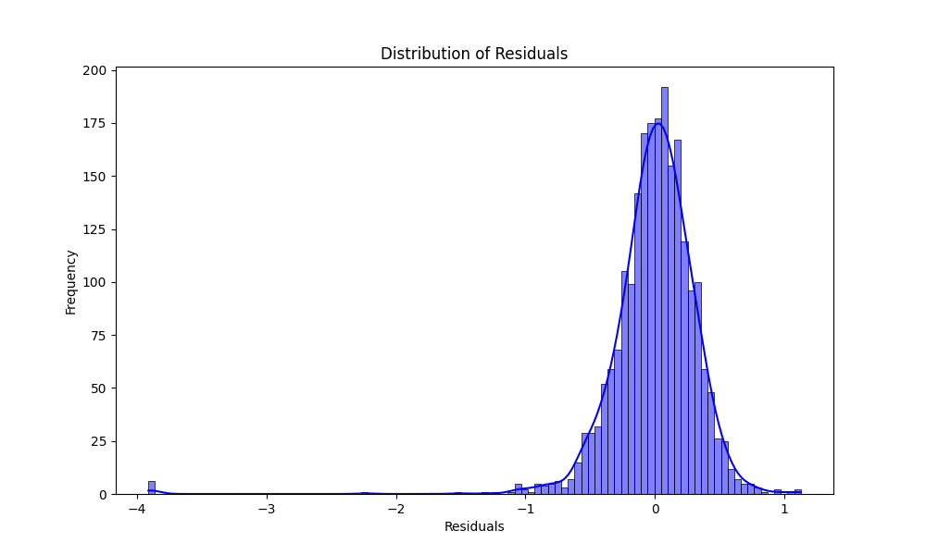
RESEARCH PAPER
Residuals Distribution
23
LAZEA ANDREEA-ELENA

Slide 24
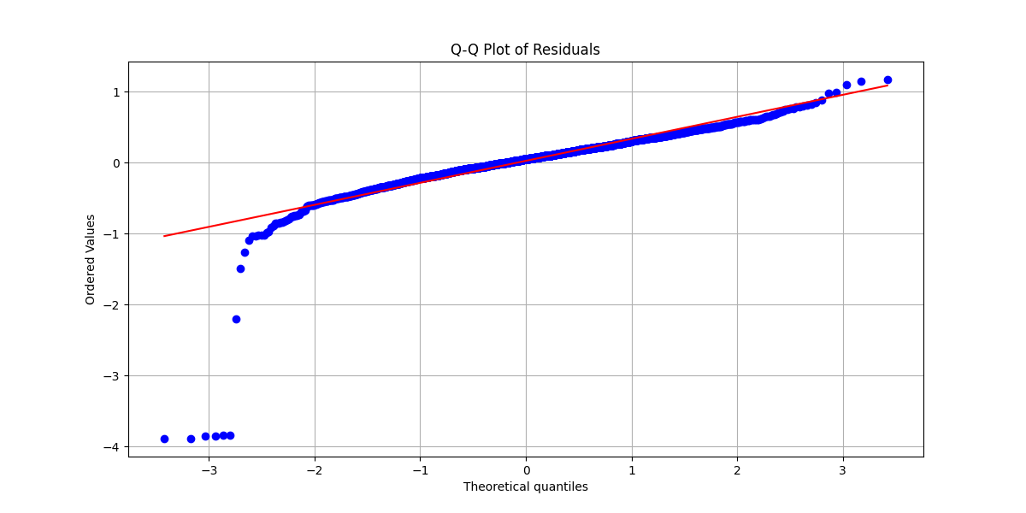
RESEARCH PAPER
Q-Q Plot Residuals
24
LAZEA ANDREEA-ELENA

Slide 25
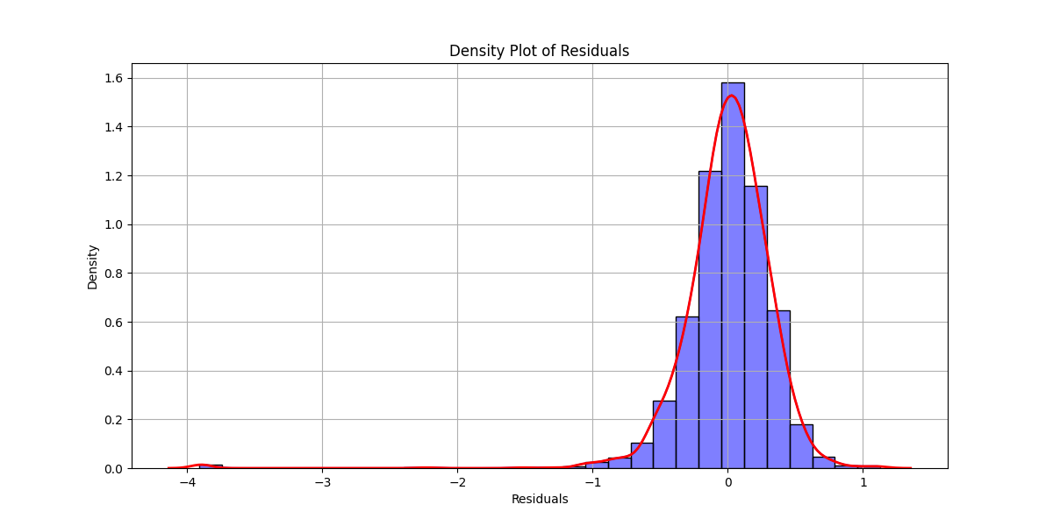
RESEARCH PAPER
Density Plot Residuals
25
LAZEA ANDREEA-ELENA

Slide 26
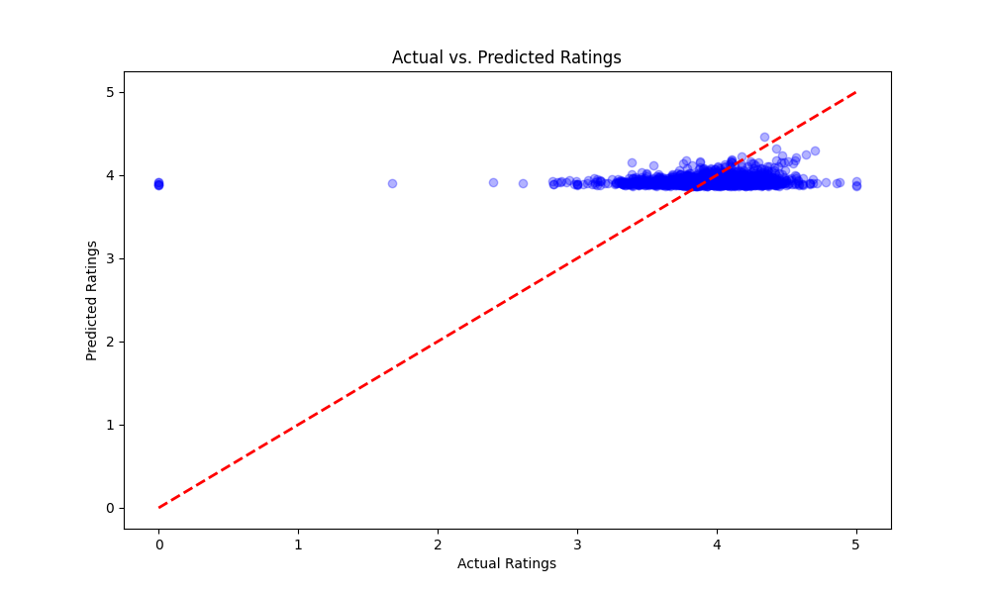
RESEARCH PAPER
Actual vs Predicted
26
LAZEA ANDREEA-ELENA

Slide 27
RESEARCH PAPER
27
Support Vector Machines
PART 5
LAZEA ANDREEA-ELENA

Slide 28
RESEARCH PAPER
28
APPROACH
Linear kernel for classification tasks
RESULTS
SVM
Accuracy: 56%
LIMITATIONS AND STRENGTHS
Strengths: Efficient with small datasets, robust performance
Limitations: Limited interpretability
LAZEA ANDREEA-ELENA

Slide 29
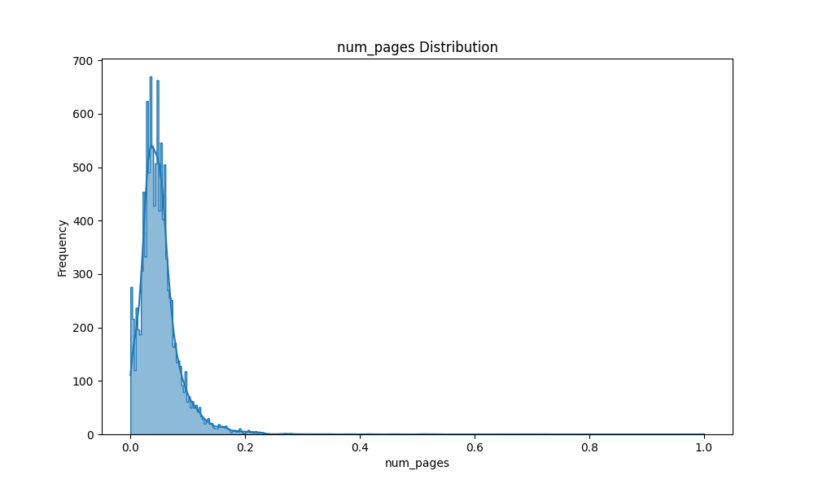
RESEARCH PAPER
Distribution of Number of Pages
29
LAZEA ANDREEA-ELENA

Slide 30
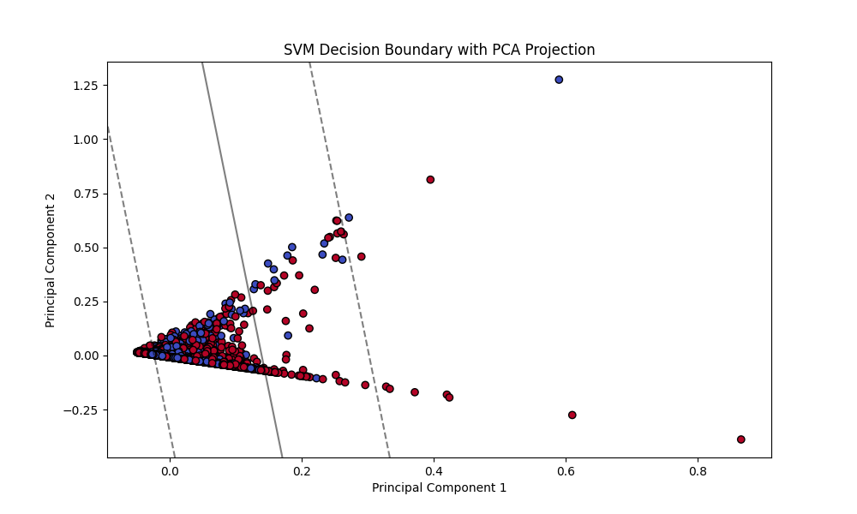
RESEARCH PAPER
Residual Analysis for SVM
30
LAZEA ANDREEA-ELENA

Slide 31
RESEARCH PAPER
31
Analysis
PART 6
LAZEA ANDREEA-ELENA

Slide 32
RESEARCH PAPER
32
Comparative Analysis
Interpretability
Accuracy
Efficiency
DECISION TREES: HIGH
NEURAL NETWORKS: MODERATE
SVM: LOW
NEURAL NETWORKS: HIGHEST
Decision Trees: Moderate
SVM: Lowest
SVM: MOST EFFICIENT
Neural Networks: Least efficient
LAZEA ANDREEA-ELENA

Slide 33
RESEARCH PAPER
33
Practical Insights
Neural Networks
Decision trees
SVM
BEST FOR EXPLAINABLE MODELS
Useful in transparent decision-making
BALANCES EFFICIENCY AND ACCURACY
Effective for moderate datasets
HIGH PRECISION FOR COMPLEX DATA
Requires computational resources
LAZEA ANDREEA-ELENA

Slide 34
RESEARCH PAPER
34
Conclusion
PART 7
LAZEA ANDREEA-ELENA

Slide 35
RESEARCH PAPER
35
Summary:
Decision Trees: Easy interpretation
SVM: Strong accuracy and efficiency
Neural Networks: Superior predictive performance
Recommendation:
Select model based on the trade-off between accuracy, interpretability, and resources
Conclusion
SUMMARY AND RECOMMENTATIONS
LAZEA ANDREEA-ELENA

